Slide 1

Butler Final Project
Group J

Slide 2
Butler Final Project
PowerBI/Tableau/ML
SQL / Pandas/Power Point
Sirine Khelifi
Kyle O’Malley
Bill Taylor
Streamlit/Heroku/ML

Slide 3
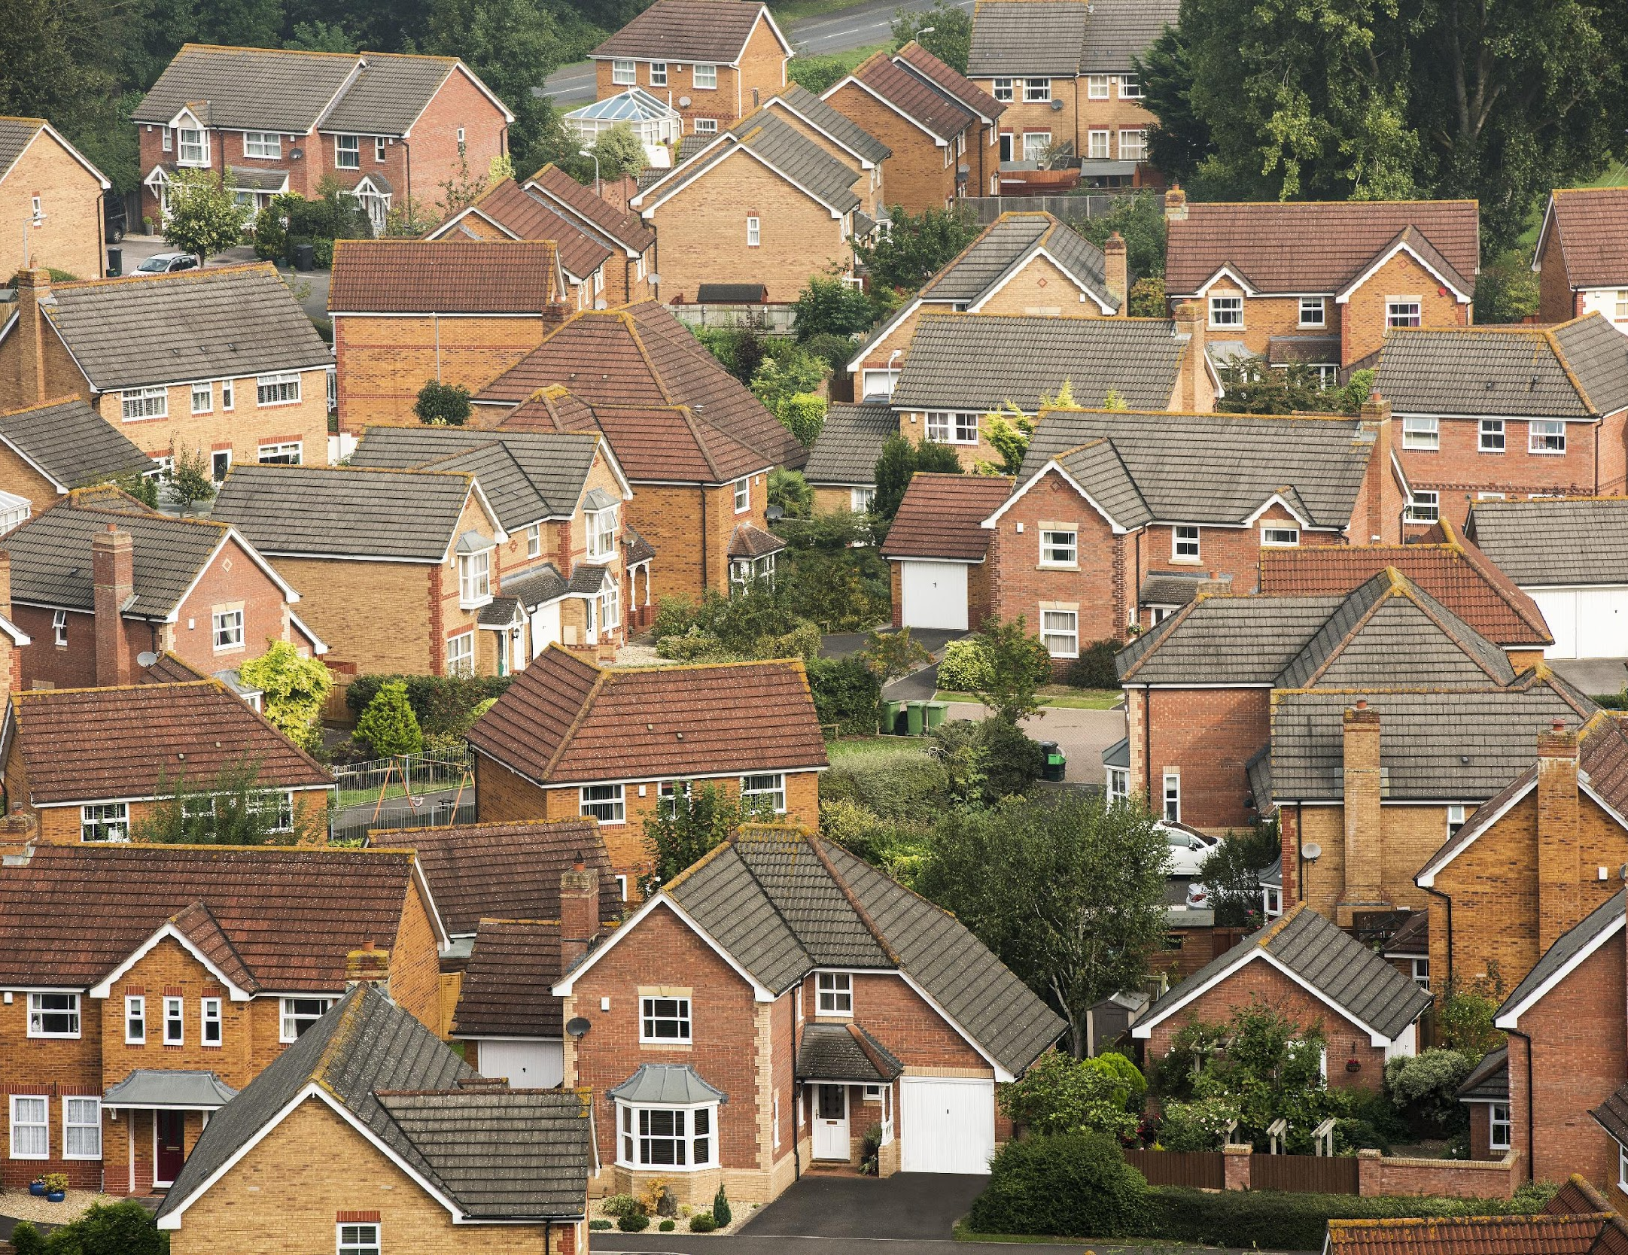
Home Value Predictor
We wanted to create a way to predict the average home values for a specific Zip code and Date
Dashboard visualization to explore average home values
Used Machine Learning for predictions

Slide 4

HERE IS THE APP!
HTTPS://PROJECT3-GROUPJ.HEROKUAPP.COM/

Slide 5

ETL Steps in postgresql and pandas
Read data from CSV and transformed in pandas, and then exported to Postgres for clean up.
Created three database, one for IN, the MW, and total US
Notes:
Bill:
Download CSV data from https://www.zillow.com/research/data/ that has average home prices by zipcode from 1996 (the beginning of Zillow) to present.
Turned the data around in Pandas from very wide to narrow, expanding 36K rows to 9 million rows

Slide 6

Tableau steps & map
Database/extract
Dashboard: Map plotting Midwest zip codes & Avg home values using date filter.
Tableau public
Notes:
Sirene:

Slide 7

Machine learning using SCIKIT and ONE-HOT
Drop columns not needed
One Hot encoding for categorical data(County)
manipulated data format to use for user input.
Reshaping, scaling and fitting features
Training & testing using Linear Regression
Saved the Linear regression model, X and Y scalers using pickle.
Notes:
Kyle:

Slide 8

Streamlit
Python web application creator without front-end
development
Machine Learning uploaded and used for predictions
Notes:
Can run regular python code directly in the web application, and write to the web app with simple, straightforward commands

Slide 9

Challenges/ Q&A
Power BI/Tableau Connections
Machine Learning
Zip Codes
Streamlit Troubleshooting
Heroku Database Limitations

